Slide 1
Work Report
2016.01.04 王辰骥

Slide 2
Esophageal Cancer Methylation Project
Background
Esophageal cancer is one of the most aggressive malignant tumors with 5-year survival rate less than 10% and occurs at a relatively high frequency in certain areas of China.
It is now well established that widespread epigenetic changes, including of DNA methylation profiles, relative to non-neoplastic tissue are a characteristic of many cancer types.
Methylation of specific gene promoters can be a hallmark of different cancer types and can be used in diagnosis and classification of cancers.
There is considerable potential for the development of new DNA methylation biomarkers or panels to improve the sensitivity and specificity of current cancer detection tests.

Slide 3
Recent Work
Six genes(BTNL9,GALR3,OSR2,TBX15,TLX1,TTBK1) were selected as candidate genes according to TCGA database. Using bisulfite sequencing to validate the methylation level in our tissue samples, more candidate genes are needed to improve the sucess rate.
TM4SF19(transmembrane 4 L six family member 19),C2orf48(chromosome 2 open reading frame 48),MKI67(marker of proliferation Ki-67),MEST(mesoderm specific transcript),PARP10(poly(ADP-ribose) polymerase family member 10),ANO1(anoctamin 1, calcium activated chloride channel),IGF2BP3(insulin like growth factor 2 mRNA binding protein 3),MAD1L1(MAD1 mitotic arrest deficient-like 1) are selected as new cadidate genes according to their methylation and expression abnormals in TCGA database.
Quantitative real-time PCR in about 30 pairs of ESCC tissue for these new selected candidate genes has been finished.I will show the results and TCGA data in this report.

Slide 4
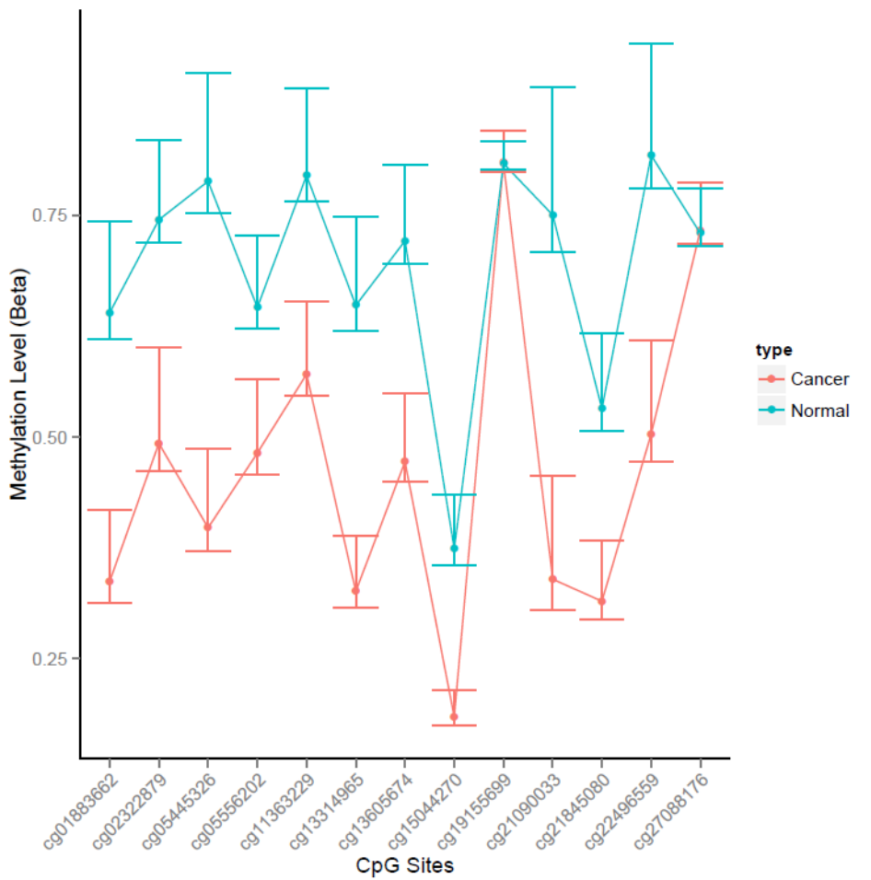
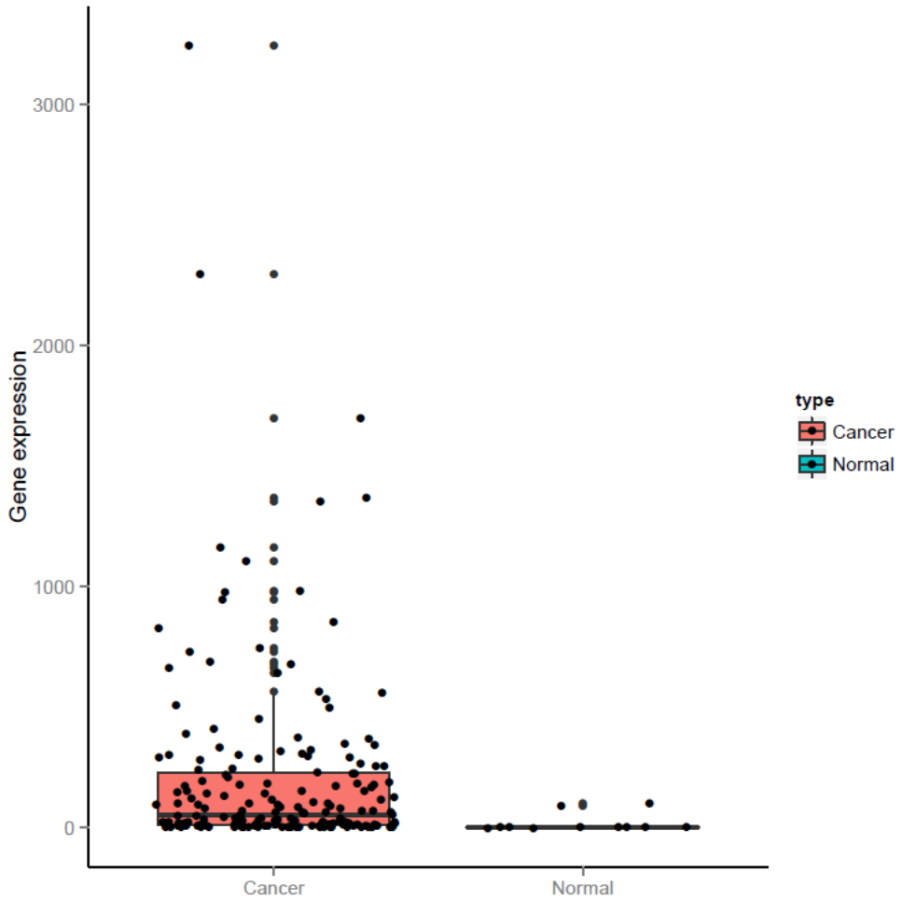
TM4SF19 in database

Slide 5
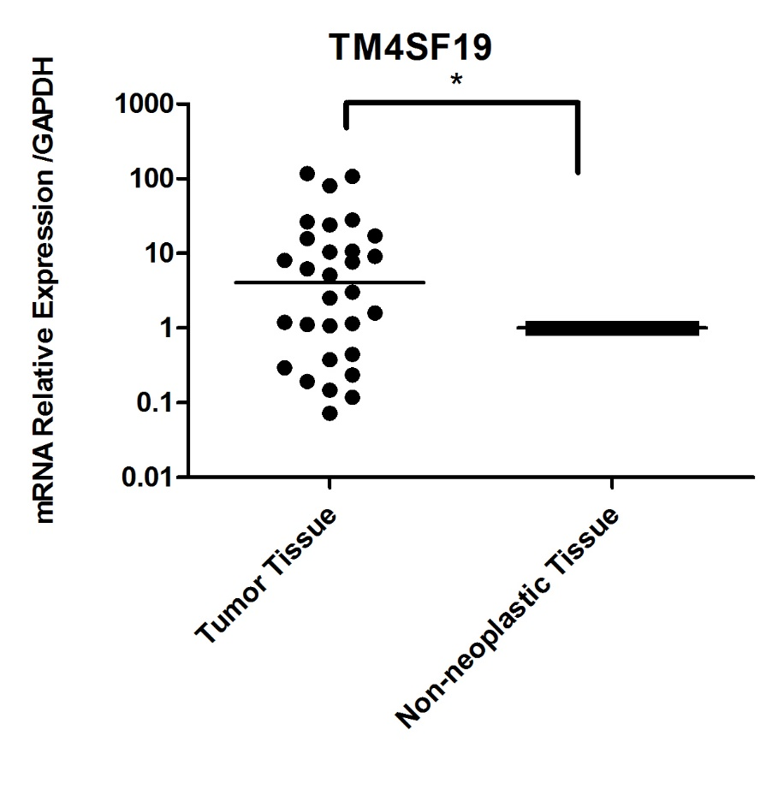
Expression of TM4SF19 in Tissue Samples
It shows downregulated in 7 pairs of tissues,upregulated in 18 pairs of tissues and no obvious change in 5 pairs of tissues.
In paired t-test p=0.0105

Slide 6
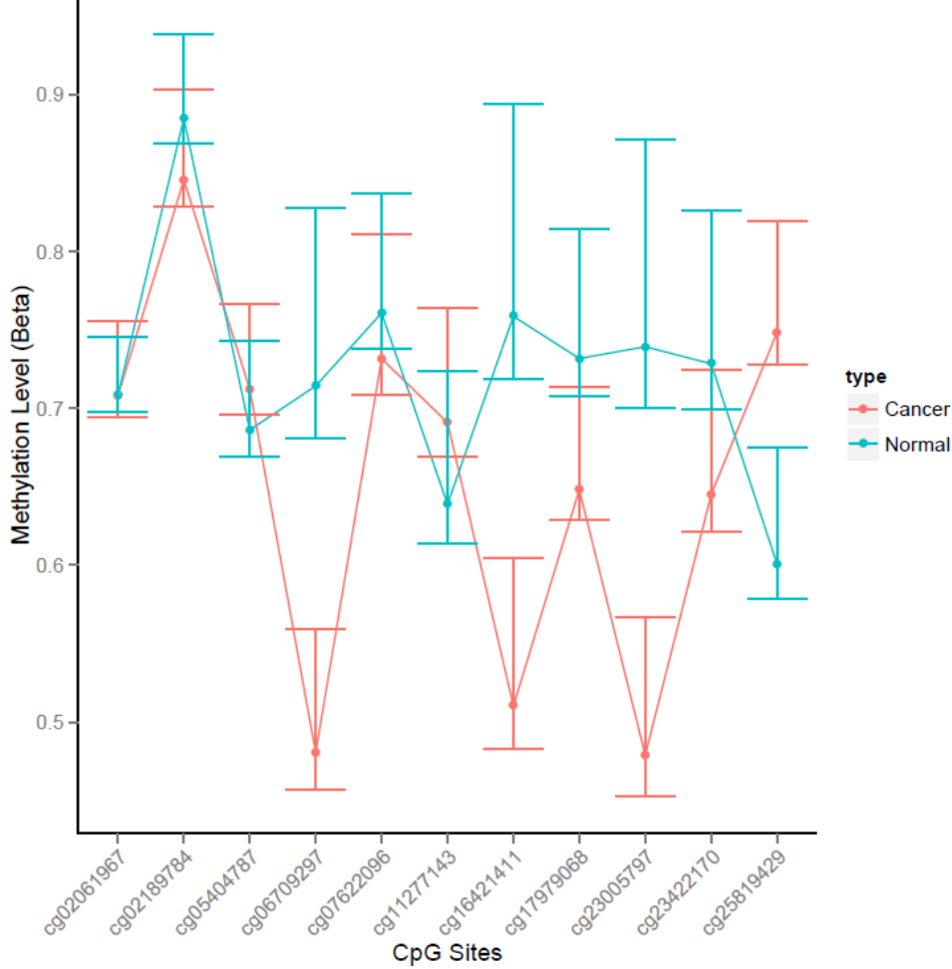
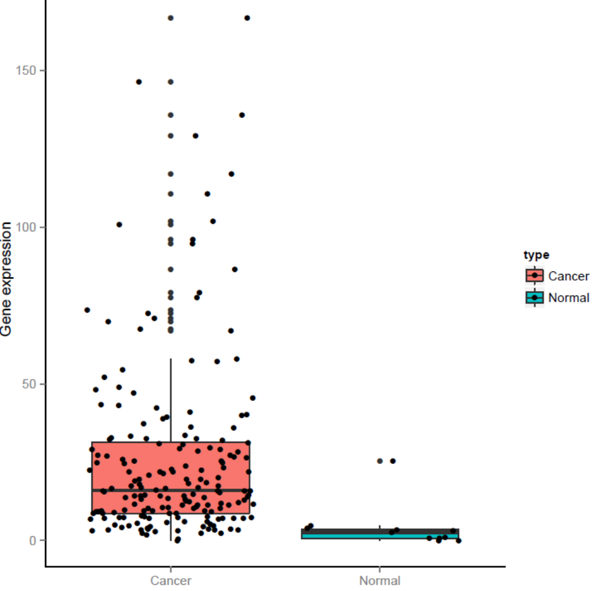
C2orf48 in database

Slide 7
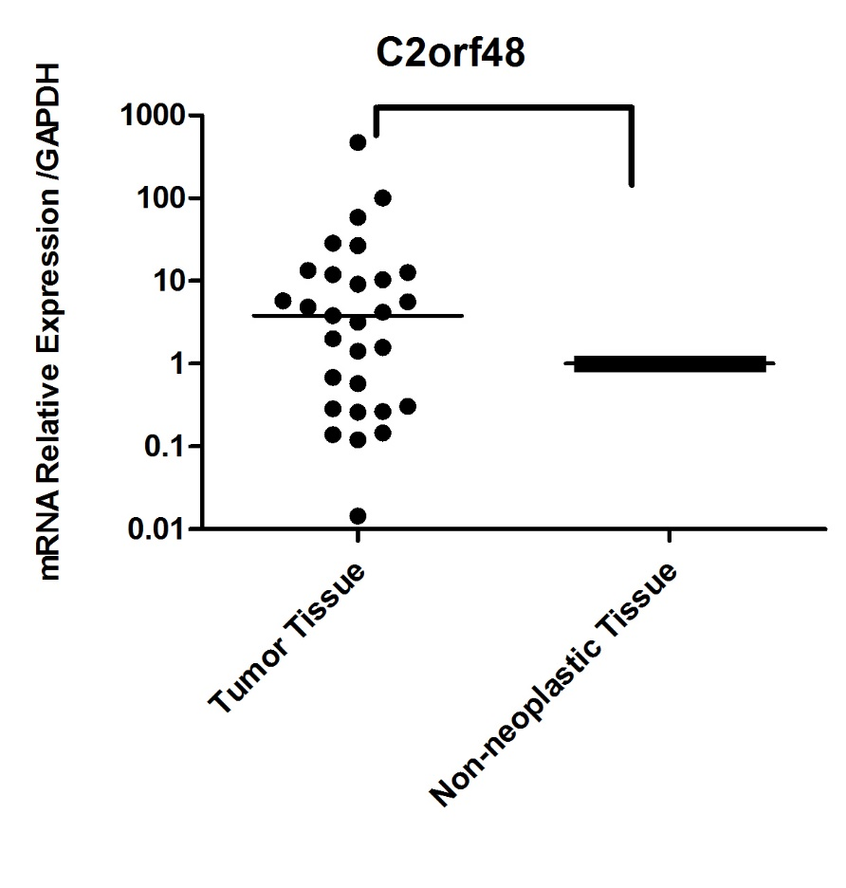
Expression of C2orf48 in Tissue Samples
It shows downregulated in 10 pairs of tissues,upregulated in 18 pairs of tissues and no obvious change in 1 pairs of tissues.
In paired t-test p=0.1248

Slide 8
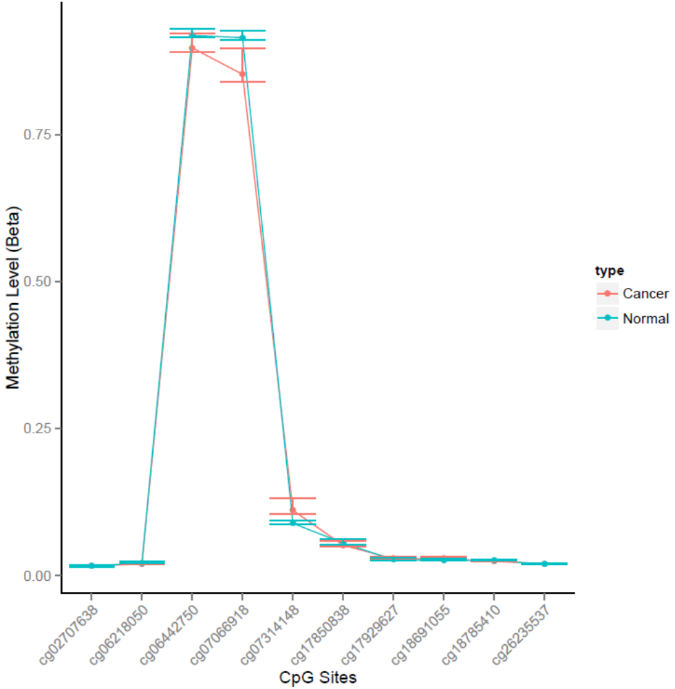
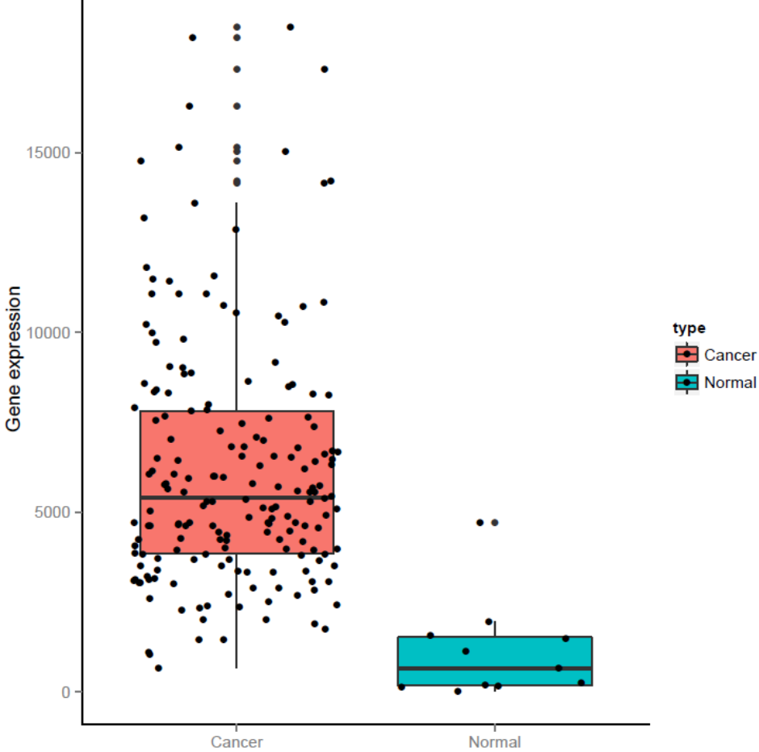
MKI67 in database

Slide 9
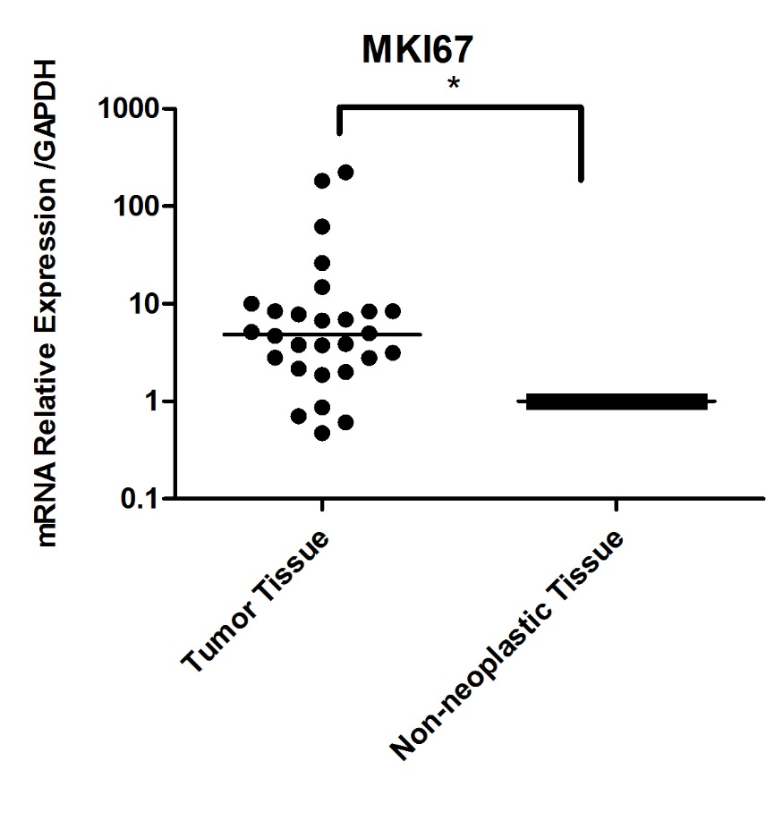
Expression of MKI67 in Tissue Samples
It shows downregulated in 4 pairs of tissues,upregulated in 24 pairs of tissues.
In paired t-test p=0.0473

Slide 10
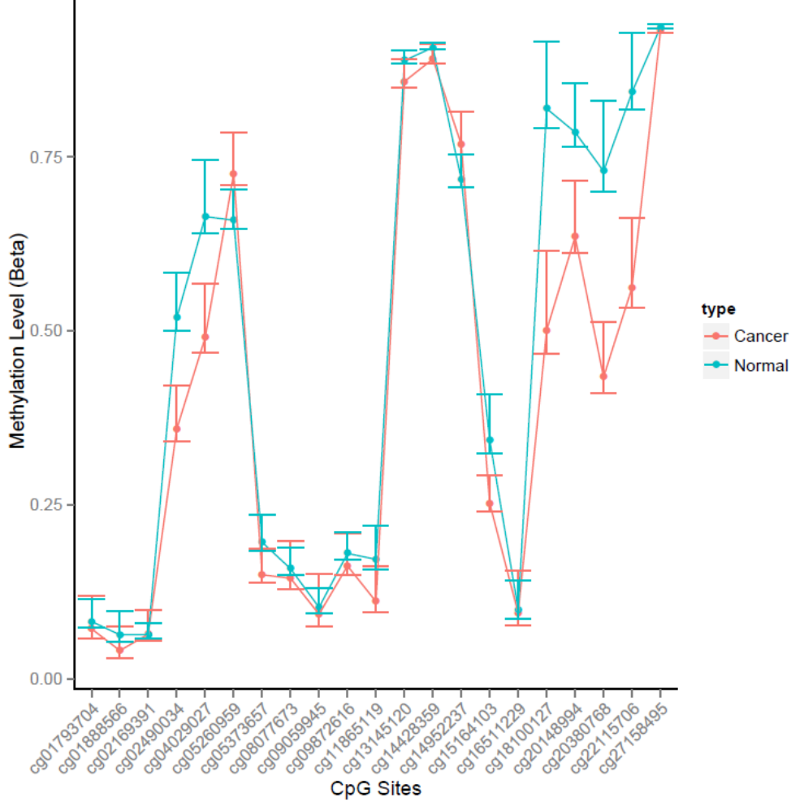
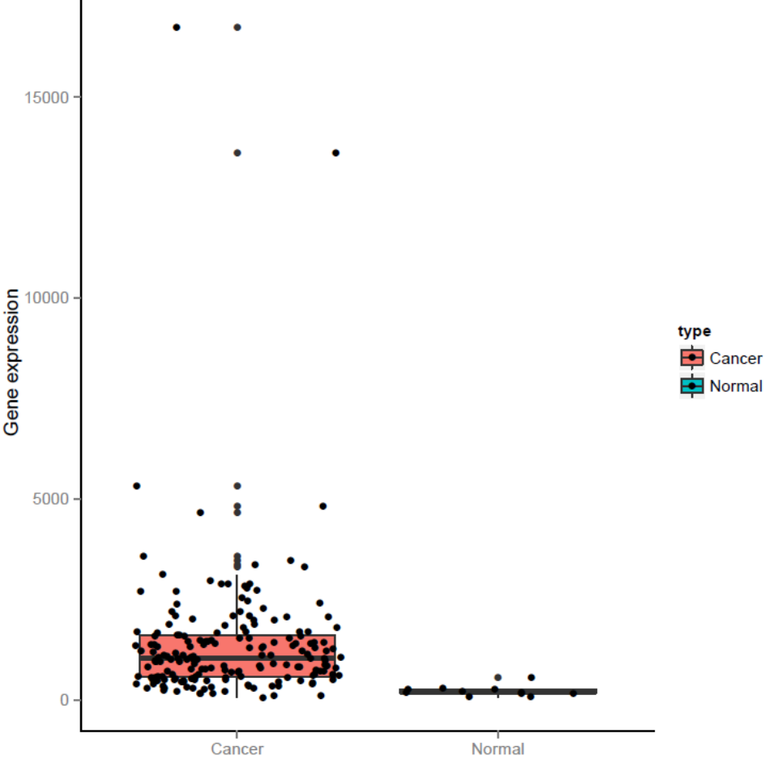
MEST in database

Slide 11
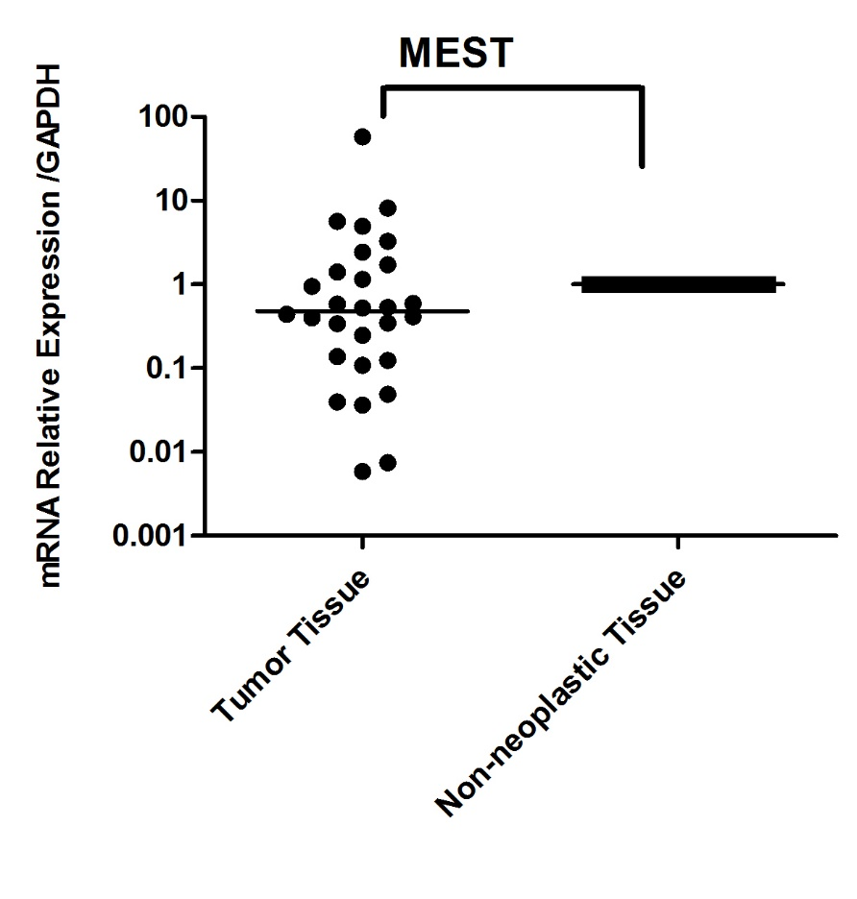
Expression of MEST in Tissue Samples
It shows downregulated in 18 pairs of tissues,upregulated in 7 pairs of tissues and no obvious change in 3 pairs of tissues.
In paired t-test p=0.2721

Slide 12
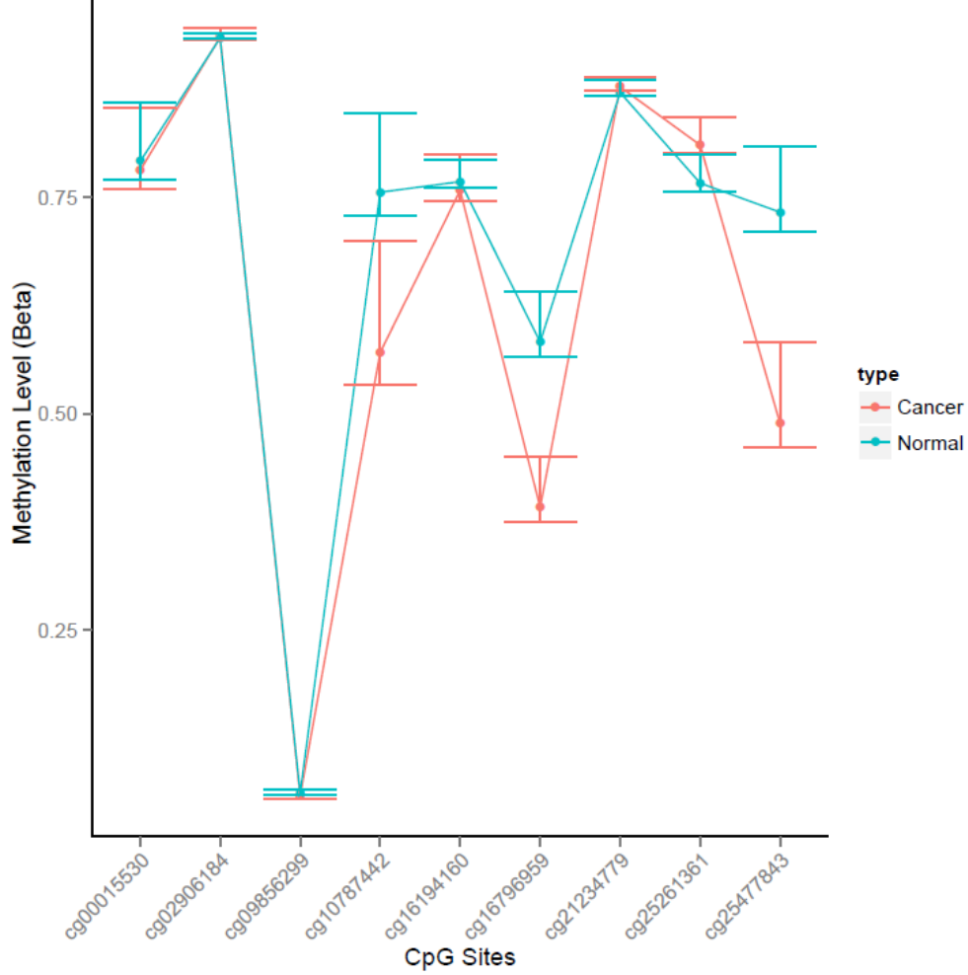
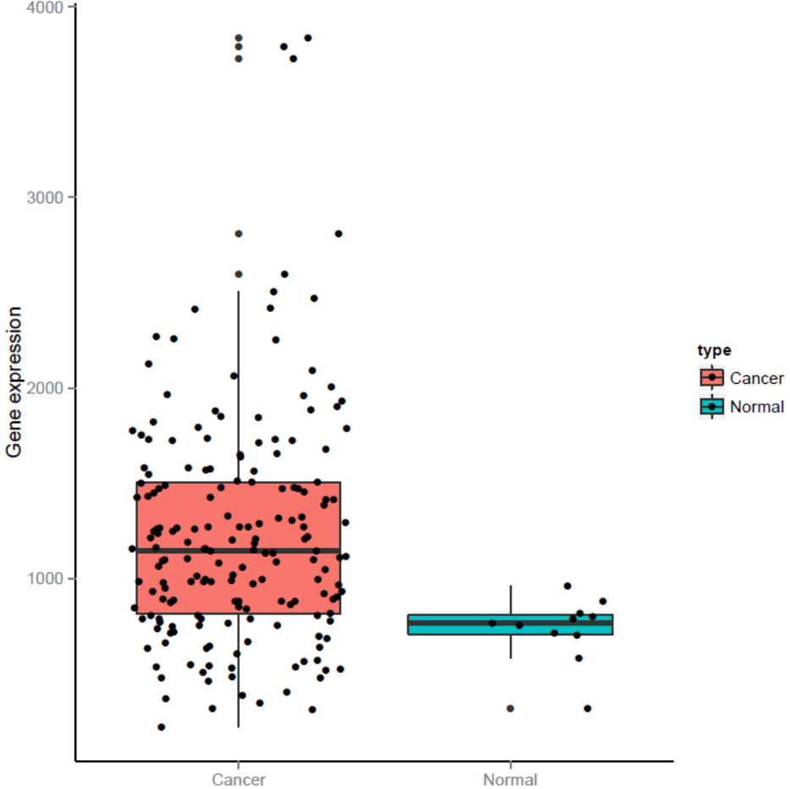
PARP10 in database

Slide 13
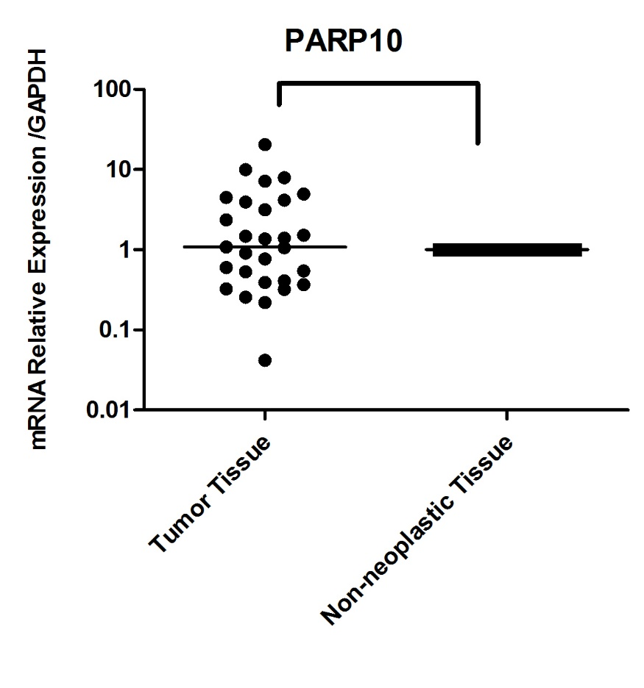
Expression of PARP10 in Tissue Samples
It shows downregulated in 11 pairs of tissues,upregulated in 10 pairs of tissues and no obvious change in 8 pairs of tissues.
In paired t-test p=0.1248

Slide 14
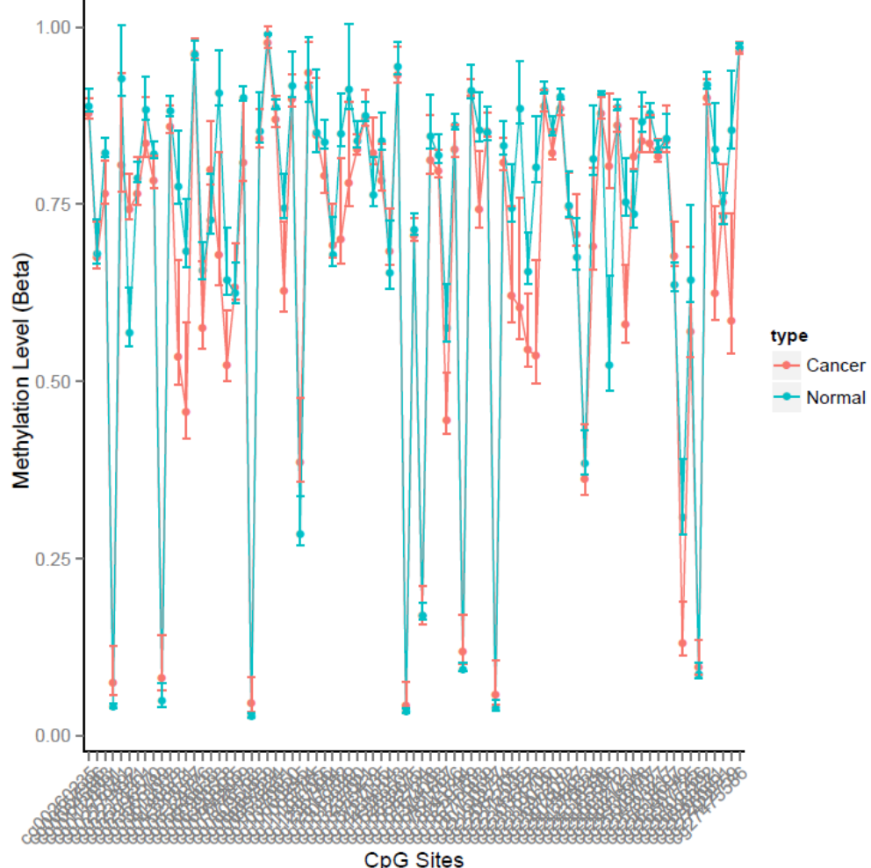
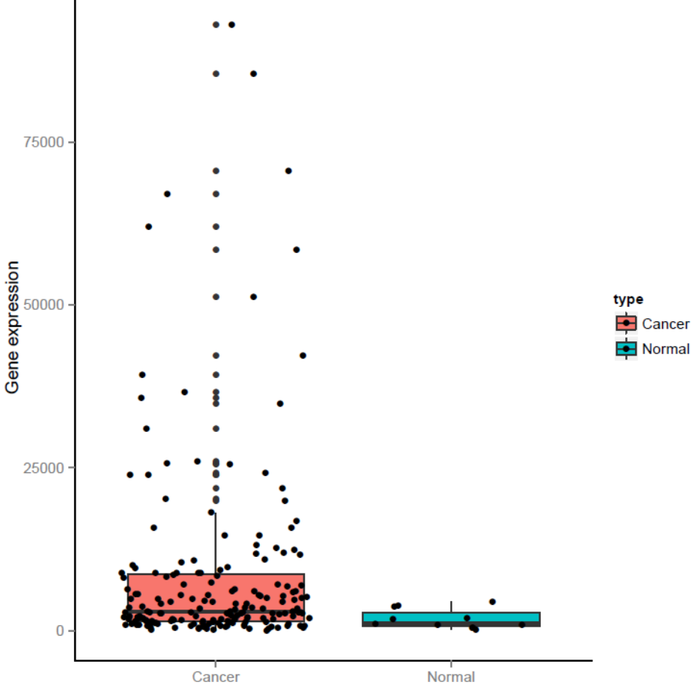
ANO1 in database

Slide 15
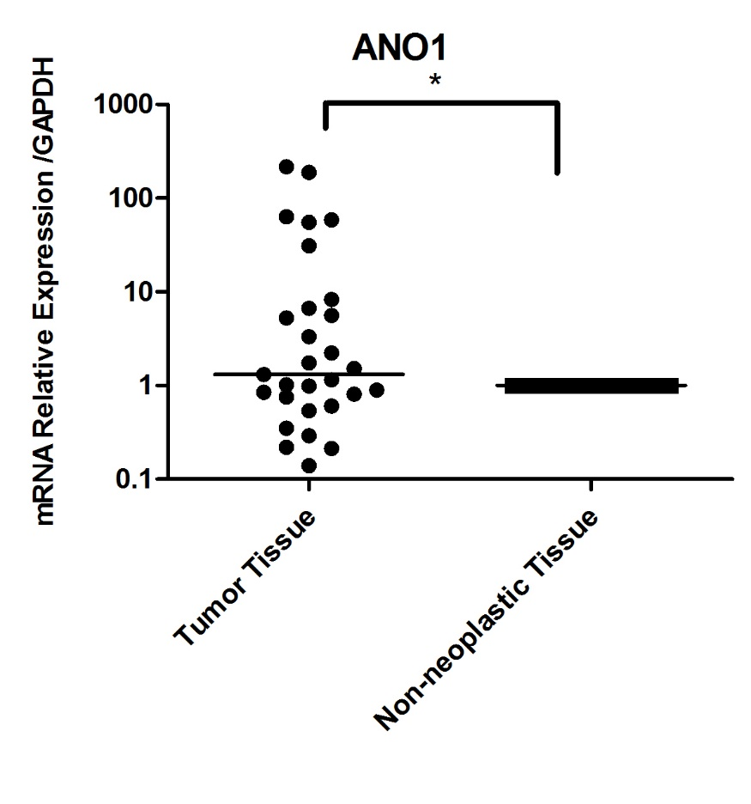
Expression of ANO1 in Tissue Samples
It shows downregulated in 10 pairs of tissues,upregulated in 13 pairs of tissues and no obvious change in 5 pairs of tissues.
In paired t-test p=0.0364

Slide 16
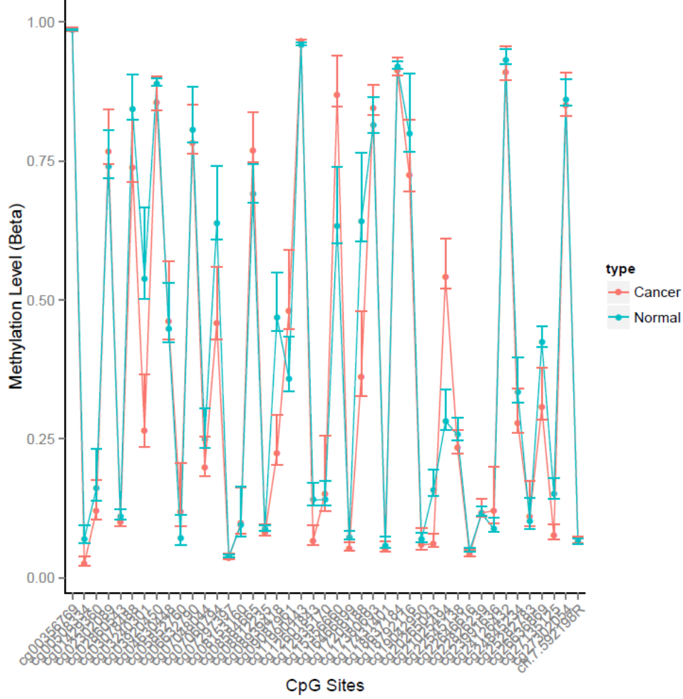
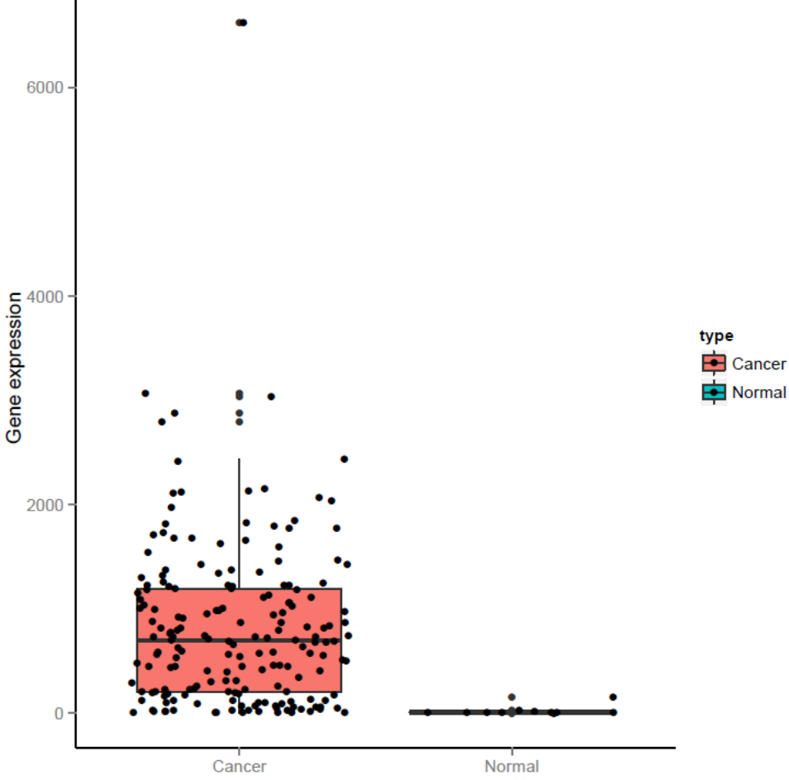
IGF2BP3 in database

Slide 17
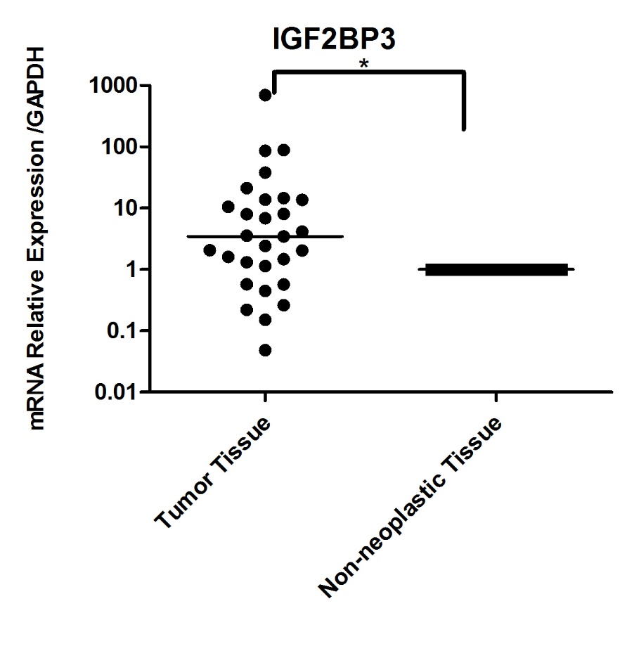
Expression of IGF2BP3 in Tissue Samples
It shows downregulated in 7 pairs of tissues,upregulated in 19 pairs of tissues and no obvious change in 3 pairs of tissues.
In paired t-test p=0.0280

Slide 18
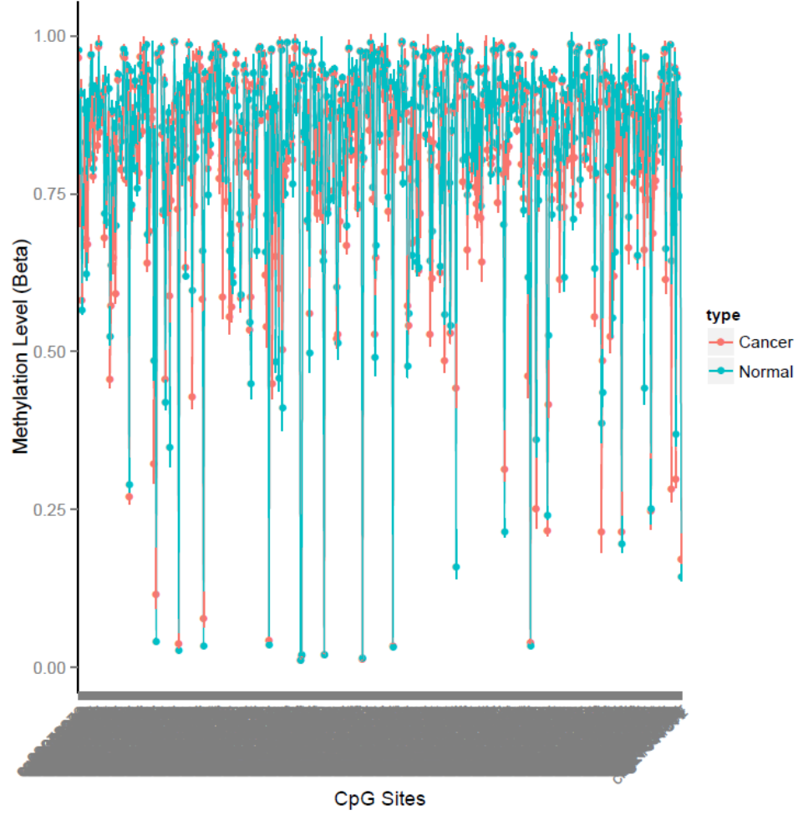
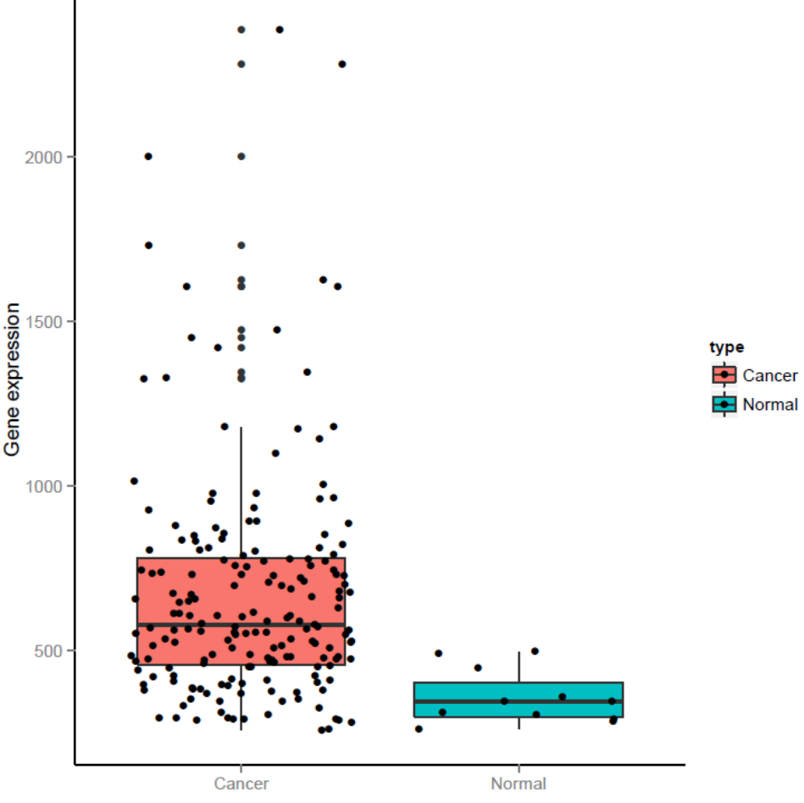
MAD1L1 in database

Slide 19
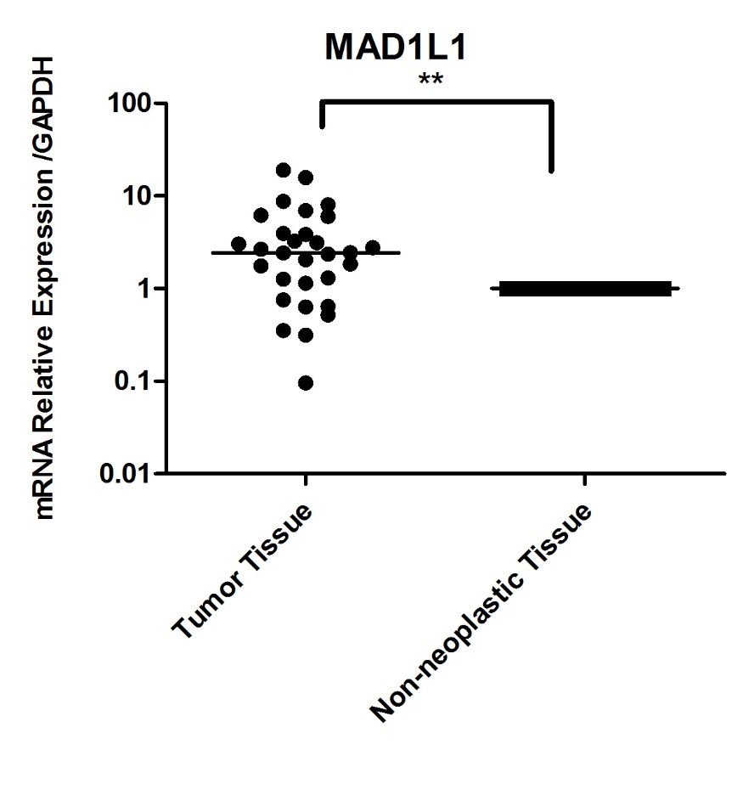
Expression of MAD1L1 in Tissue Samples
It shows downregulated in 7 pairs of tissues,upregulated in 20 pairs of tissues and no obvious change in 3 pairs of tissues.
In paired t-test p=0.0016

Slide 20
Conclusion
So that 4 of TM4SF19, C2orf48,MKI67, ANO1,IGF2BP3 and MAD1L1 may be slected according to their cpg site details to put in the panel to consist a 10 gene diagnosis panel fot bisulfite sequencing.
Expansion
TM4SF19 and C2orf48 have no items found in NCBI
MKI67:Ki-67 is a marker that reflects cell proliferation.In ESCC, silencing of TKTL1 expression decreased cell proliferation through inhibiting the expression of MKI67 and cyclins including Ccna2, Ccnb1, Ccnd1 and Ccne1.
ANO1: ANO1/TMEM16A has recently been shown to be highly expressed in several epithelium originated carcinomas.In head and neck squamous cell carcinoma (HNSCC), overexpression of ANO1(TMEM16A) is associated with decreased patient survival.The lower levels of ANO1(TMEM16A) expression in HPV-positive tumors can be attributed to both a combination of copy number alteration and promoter methylation at the DNA level.

Slide 21
IGF2BP3:IGF2BP3 (IMP3) is a mRNA binding protein that regulates IGF2 translation and function during embryogenesis.Patients with squamous cell esophageal cancers strongly expressing IGF2BP3 tended to respond poorly to chemoradiation.These data suggest that IGF2BP3 may be a key marker of radiosensitivity that diminishes the susceptibility of squamous cell esophageal cancer cells to radiotherapy.
MAD1L1:Mitotic arrest deficient-like 1 (MAD1L1) 's dysfunction is associated with chromosomal instability plays a pathogenic role in a few human cancers.MAD1L1 positive expression may be associated with tumour progression and metastasis in SCLCs.

Slide 22
Thank You

